Slide 1
Do report cards tell consumers anything they don’t already know? The case of Medicare HMOs
Dafny and Dranove 2008
Presented by Martha Wetzel

Slide 2
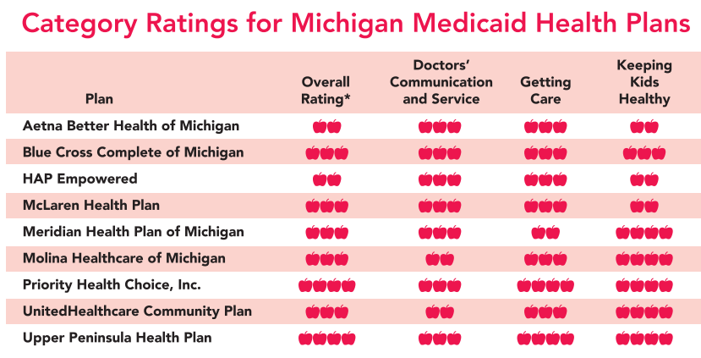
Throwback to Consulting Days

Slide 3
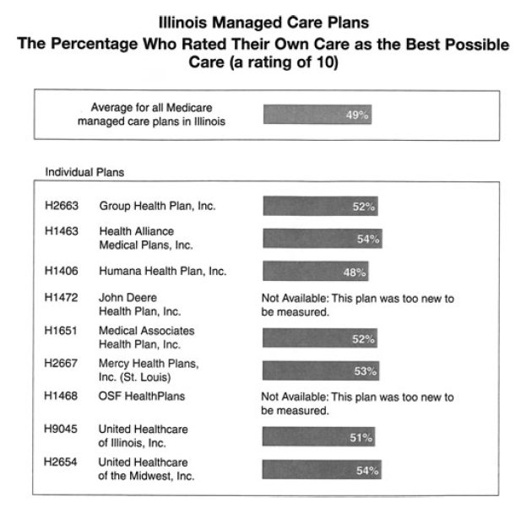
Background
Medicare beneficiaries can choose from traditional Medicare (i.e., FFS) or an HMO plan
In 1999, CMS added two quality measures to the 70+ page Medicare info booklet

Slide 4
Research Question
How much of consumer choice of Medicare plans is driven by report cards versus market-based learning?
Market-based learning
Measured by the trend toward higher-quality plans manifested in the years prior to the intervention
Possible mechanisms:
Word of mouth
Referrals by health-care providers
Personal experience
Privately organized report cards
Advertising

Slide 5
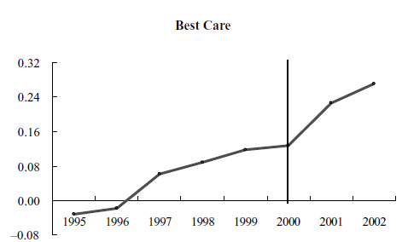
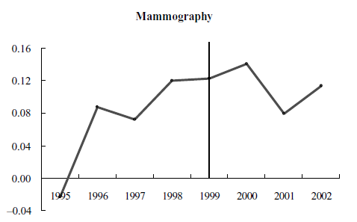
Contribution/Findings Preview
Notes:
The reported coefficients are estimates of the mean marginal utilities associated with the corresponding scores in different years. Thus, the positive
coefficients on the trend variables imply that consumers value higher-quality plans more over time (at a decreasing rate).

Slide 6
Data
Enrollment data from the Medicare Managed Care Quarterly State/County/Plan data files for December of each year from 1994 to 2002
Plan here really means carrier, so if Aetna offers two products, such as a benefit package that includes drug coverage and one that does not, both are counted as the same Aetna plan
Quality data from Medicare HEDIS files and the Medicare Compare Database
3 quality measures included in the report card
3 additional quality measures not included in the report card
Premium information from CMS
US News carrier ratings
CPS for income

Slide 7
Analysis
Discrete choice demand model
Outside good: traditional Medicare
Separate nest for the HMOs
$$u_{ijct}=x_{jct}β−ap_{jct}+ξ_{jct}+{φ }_{i}ζ_{g}+\left(1−σ\right)ϵ_{ijct}$$
Subscripts:
i: individual
j: plan
c: county
t: time
g: nest
Premium
Nest dummy
Utility
Mean utility of unobserved plan-market characteristics
Observed plan-market-year characteristics

Slide 8
Analysis
$$u_{ijct}=x_{jct}β−ap_{jct}+ξ_{jct}+{φ }_{i}ζ_{g}+\left(1−σ\right)ϵ_{ijct}$$
$$x_{jct}=\sum_{l=1}^{3}{\left[score_{j}^{l}∗f\left(year_{t}\right)+score_{j}^{l}∗post_{t}^{l}\right]}+ω_{j}+k_{c}+ψ_{s}t$$
Score time trend
Report card
All the FE

Slide 9
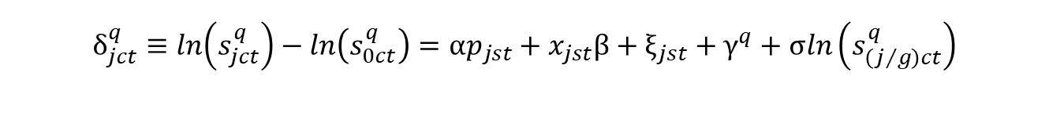
Market Share Estimation
$$δ_{jct}^{q}≡ln\left(s_{jct}^{q}\right)−ln\left(s_{0ct}^{q}\right)=αp_{jst}+x_{jst}β+ξ_{jst}+γ^{q}+σln\left(s_{\left(j/g\right)ct}^{q}\right)$$
Mean plan utility
Absolute market share – Plan j
Absolute market share – Outside good

Slide 10
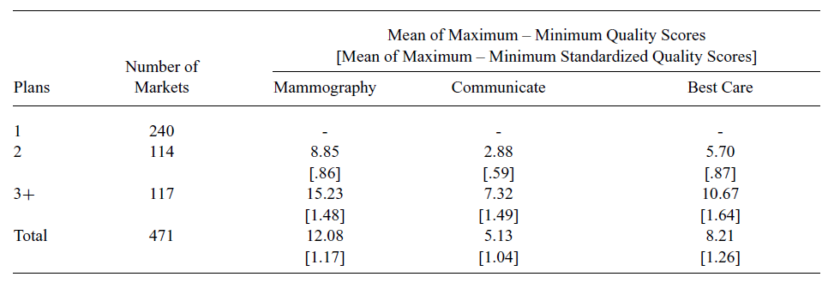
Identification: Variation

Slide 11
Identification
Identifying assumption for report card effect: no omitted factors happened simultaneously with report card that are correlated with quality
Omitted variable bias
Price and within group share could be correlated with mean utility of unobserved shocks to plan quality
E.g., if “United Healthcare of Illinois, which operates in several Illinois counties, increased its unobserved quality and price only in Cook County.”
IVs: Price
Characteristics of other counties that plan operates in and time-varying county characteristics
IVs: Within-group share
Competitors characteristics (e.g., not-for-profit ownership)

Slide 12
Threats
Supply side response
Instruments for within-group share only valid if competitors don’t respond to changes in plan j’s unobserved quality with their own changes in plan characteristics or entry/exit
Quality-time interactions are assumed to be exogenous

Slide 13
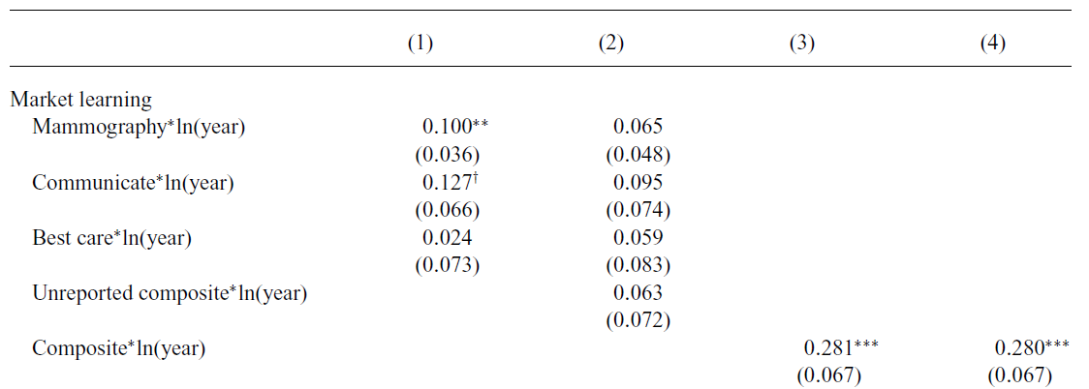
Results: Market Learning
Notes:
Model 1: Separate quality metrics, omits unreported measures
Model 2: Adds unreported quality measures
Model 3: Composite for market learning
Model 4: Adds a prescription drug coverage indicator

Slide 14

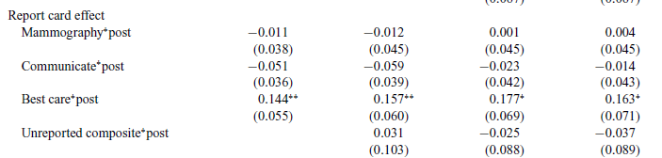
Results: Report Cards

Slide 15
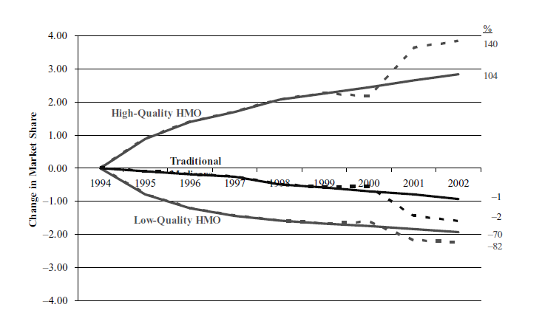



Simulation: Duopoly
Notes:
Duopoly simulation –
The solid lines correspond to mean predicted shares without report cards, and the dotted lines include the report-card Effects
Most of this increase comes at the expense of the low quality HMO, with roughly one third of additional enrollees coming from traditional Medicare.

Slide 16
Discussion
“The evidence for market-based learning implies that the effect of report cards is typically overestimated.”

Slide 17
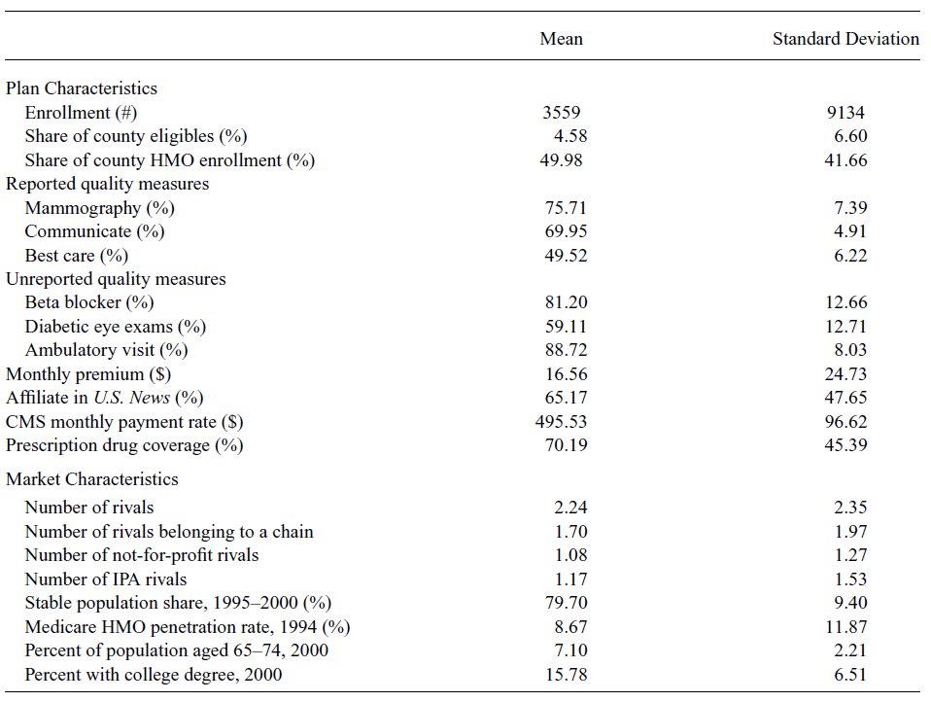
Descriptive Characteristics

